Slide 1



Smart Device Prototype TASK 2
Abdul Bhutta

Slide 2

Introducing myself
Abdul Bhutta
4th Year Student in Software Engineering
Looking to pursue graduate degree in May of 2023
https://github.com/abdulbhutta/Smart-Device-Prototype

Slide 3
Introduction
Smart Device
Captures Image and monitors temperature/humidity at an independent rate.
Data saved on SD card
Pseudocode
Implementation and design of the circuit

Slide 4
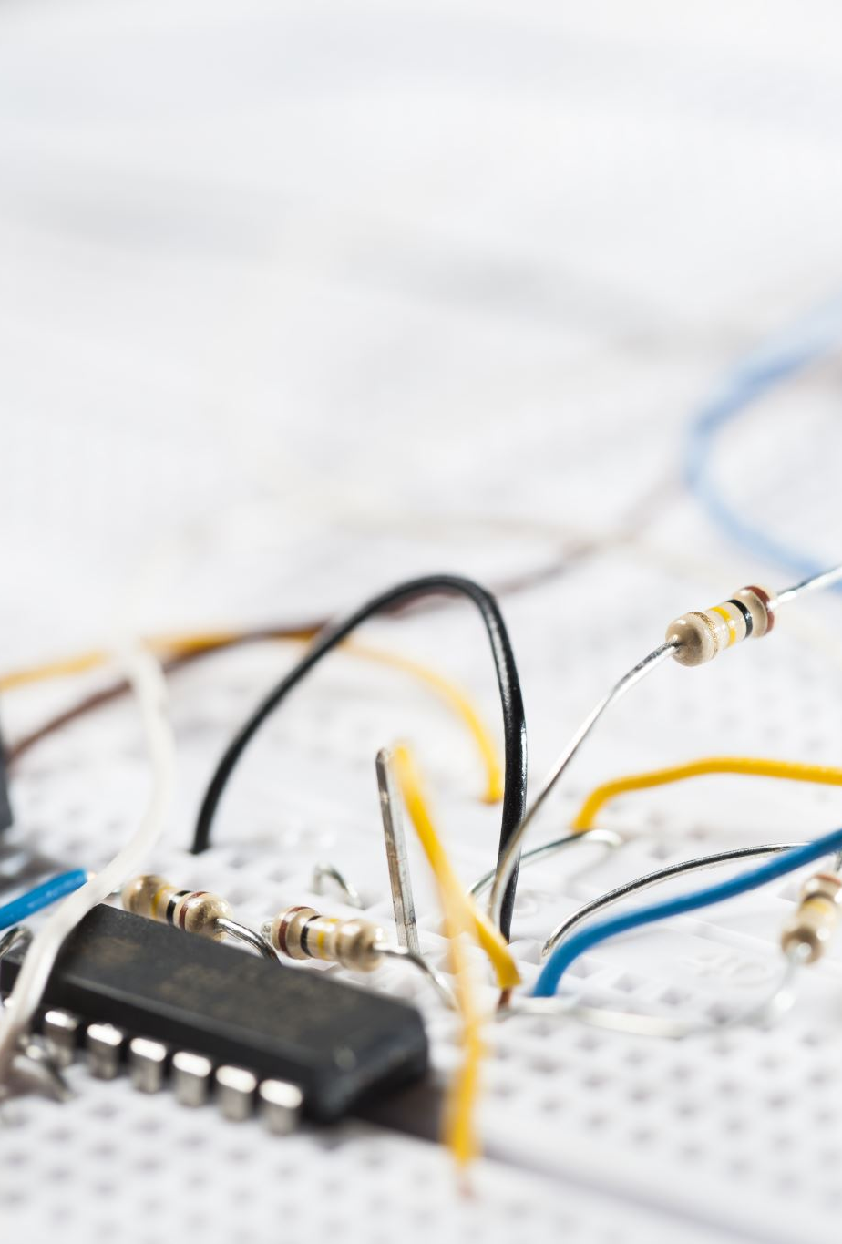
Components Required
Breadboard and wires
Arduino IDE Software
ESP32-CAM with Camera
FTDI Programmer
DHT11 Sensor
4.7 kOhms or 10 kOhms

Slide 5
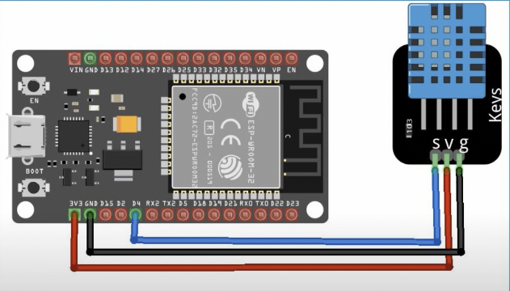
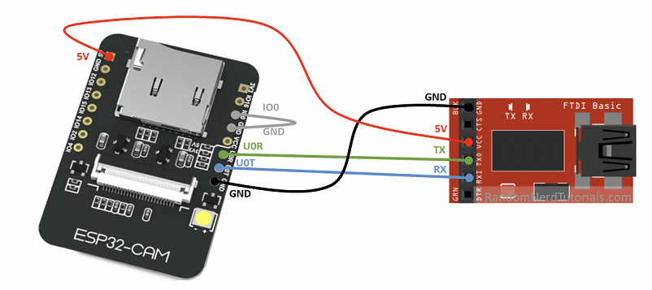
Connecting devices to the Microcontroller

Slide 6
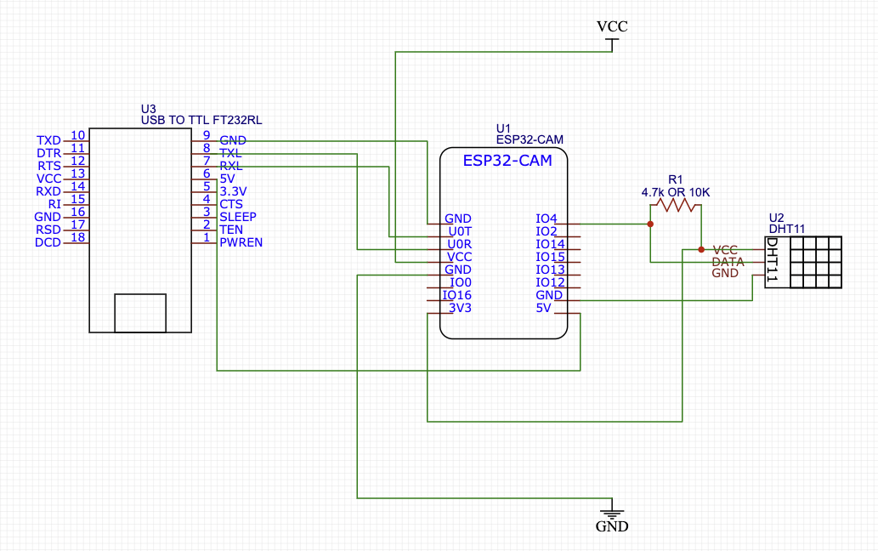
Schematic

Slide 7
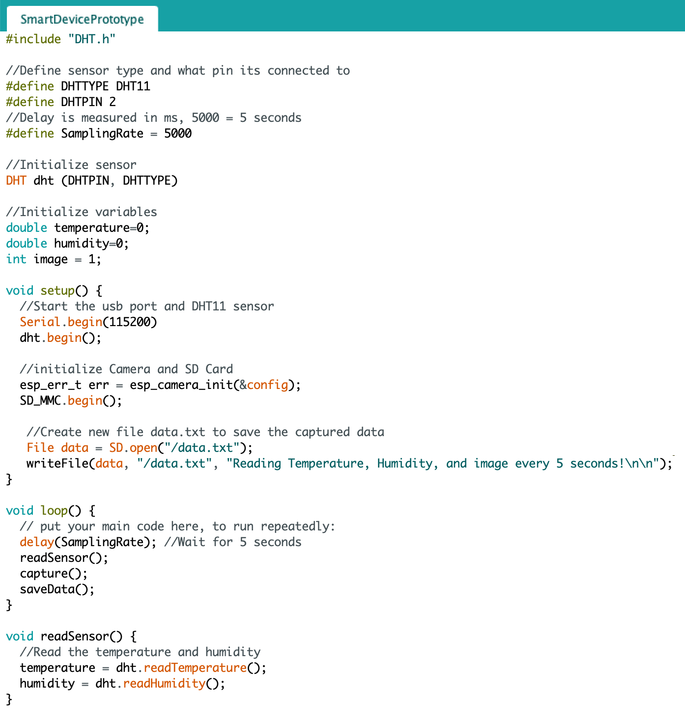
pseudocode

Slide 8
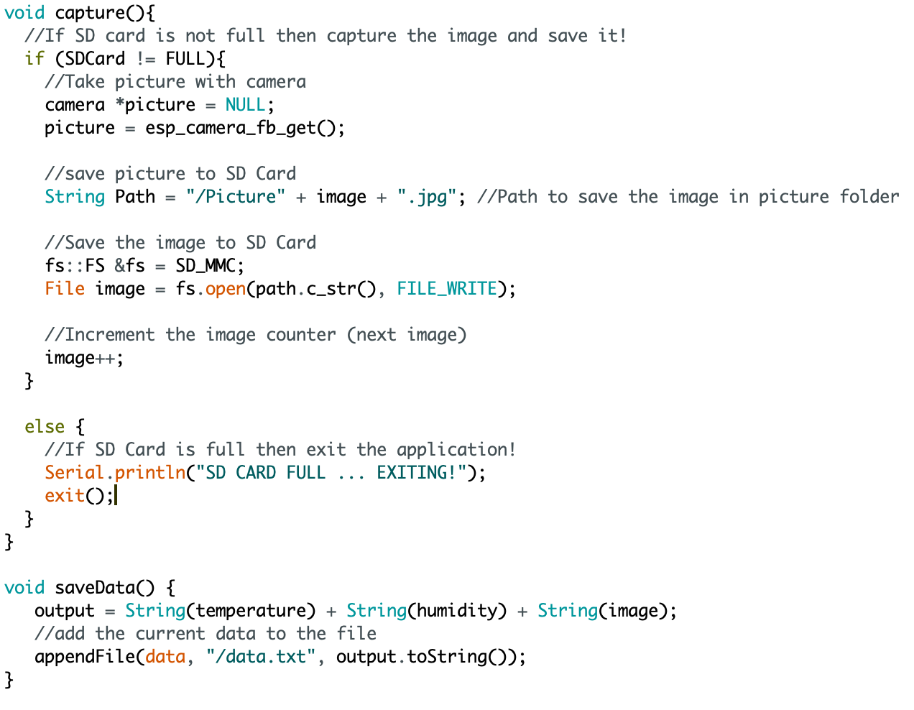
Pseudocode

Slide 9
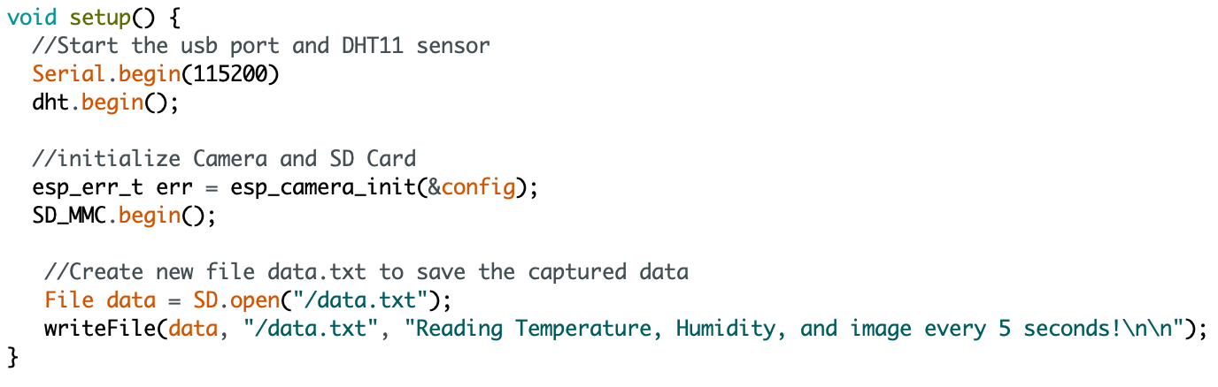
Method 1 – START UP

Slide 10
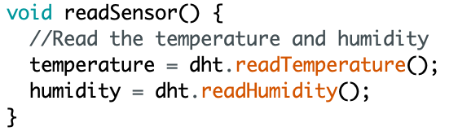
Method 2 – READSENSOR()

Slide 11
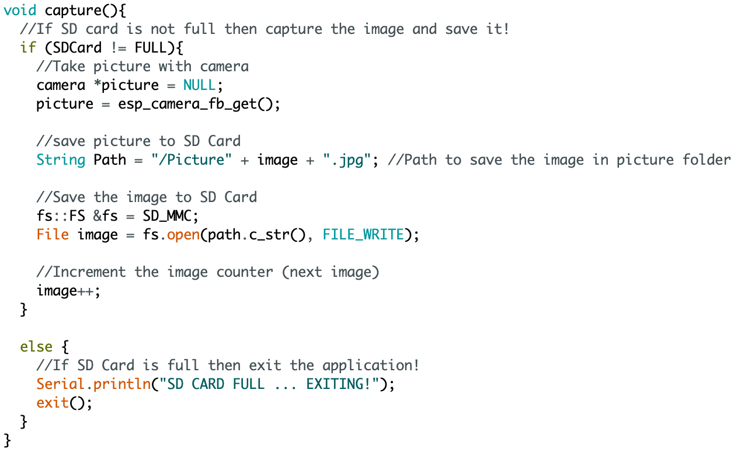
METHOD 3 – CAPTURE IMAGE

Slide 12
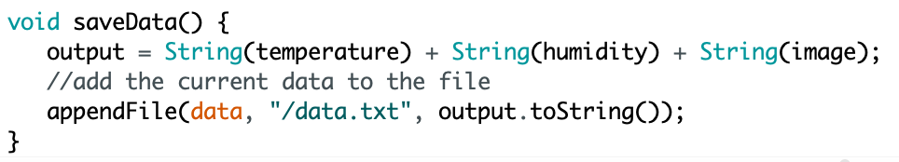
METHOD 4 - SAVE THE DATA TO A FILE

Slide 13
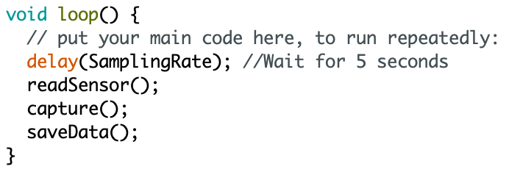
METHOD 5 - RUN THE APPLICATION UNTIL EXIT

Slide 14
Thank you!

